Slide 1
Following the Yellow Brick Code
An Extended Terminology Journey
Rob Hausam MD HL7 Working Group Meeting Dallas, TX
2024-05-22

Slide 2
This presentation
Can be downloaded here:
https://github.com/FHIR/documents/blob/master/presentations/2024-05%20Tutorials/Following_the_Yellow_Brick_Code_2024-05-22.pptx
Is licensed for use under the Creative Commons, specifically:
Creative Commons Attribution 3.0 Unported License
(Do with it as you wish – just give credit)
Acknowledgements: Jim Steel, Dion McMurtrie, Grahame Grieve, Lloyd McKenzie
2

Slide 3
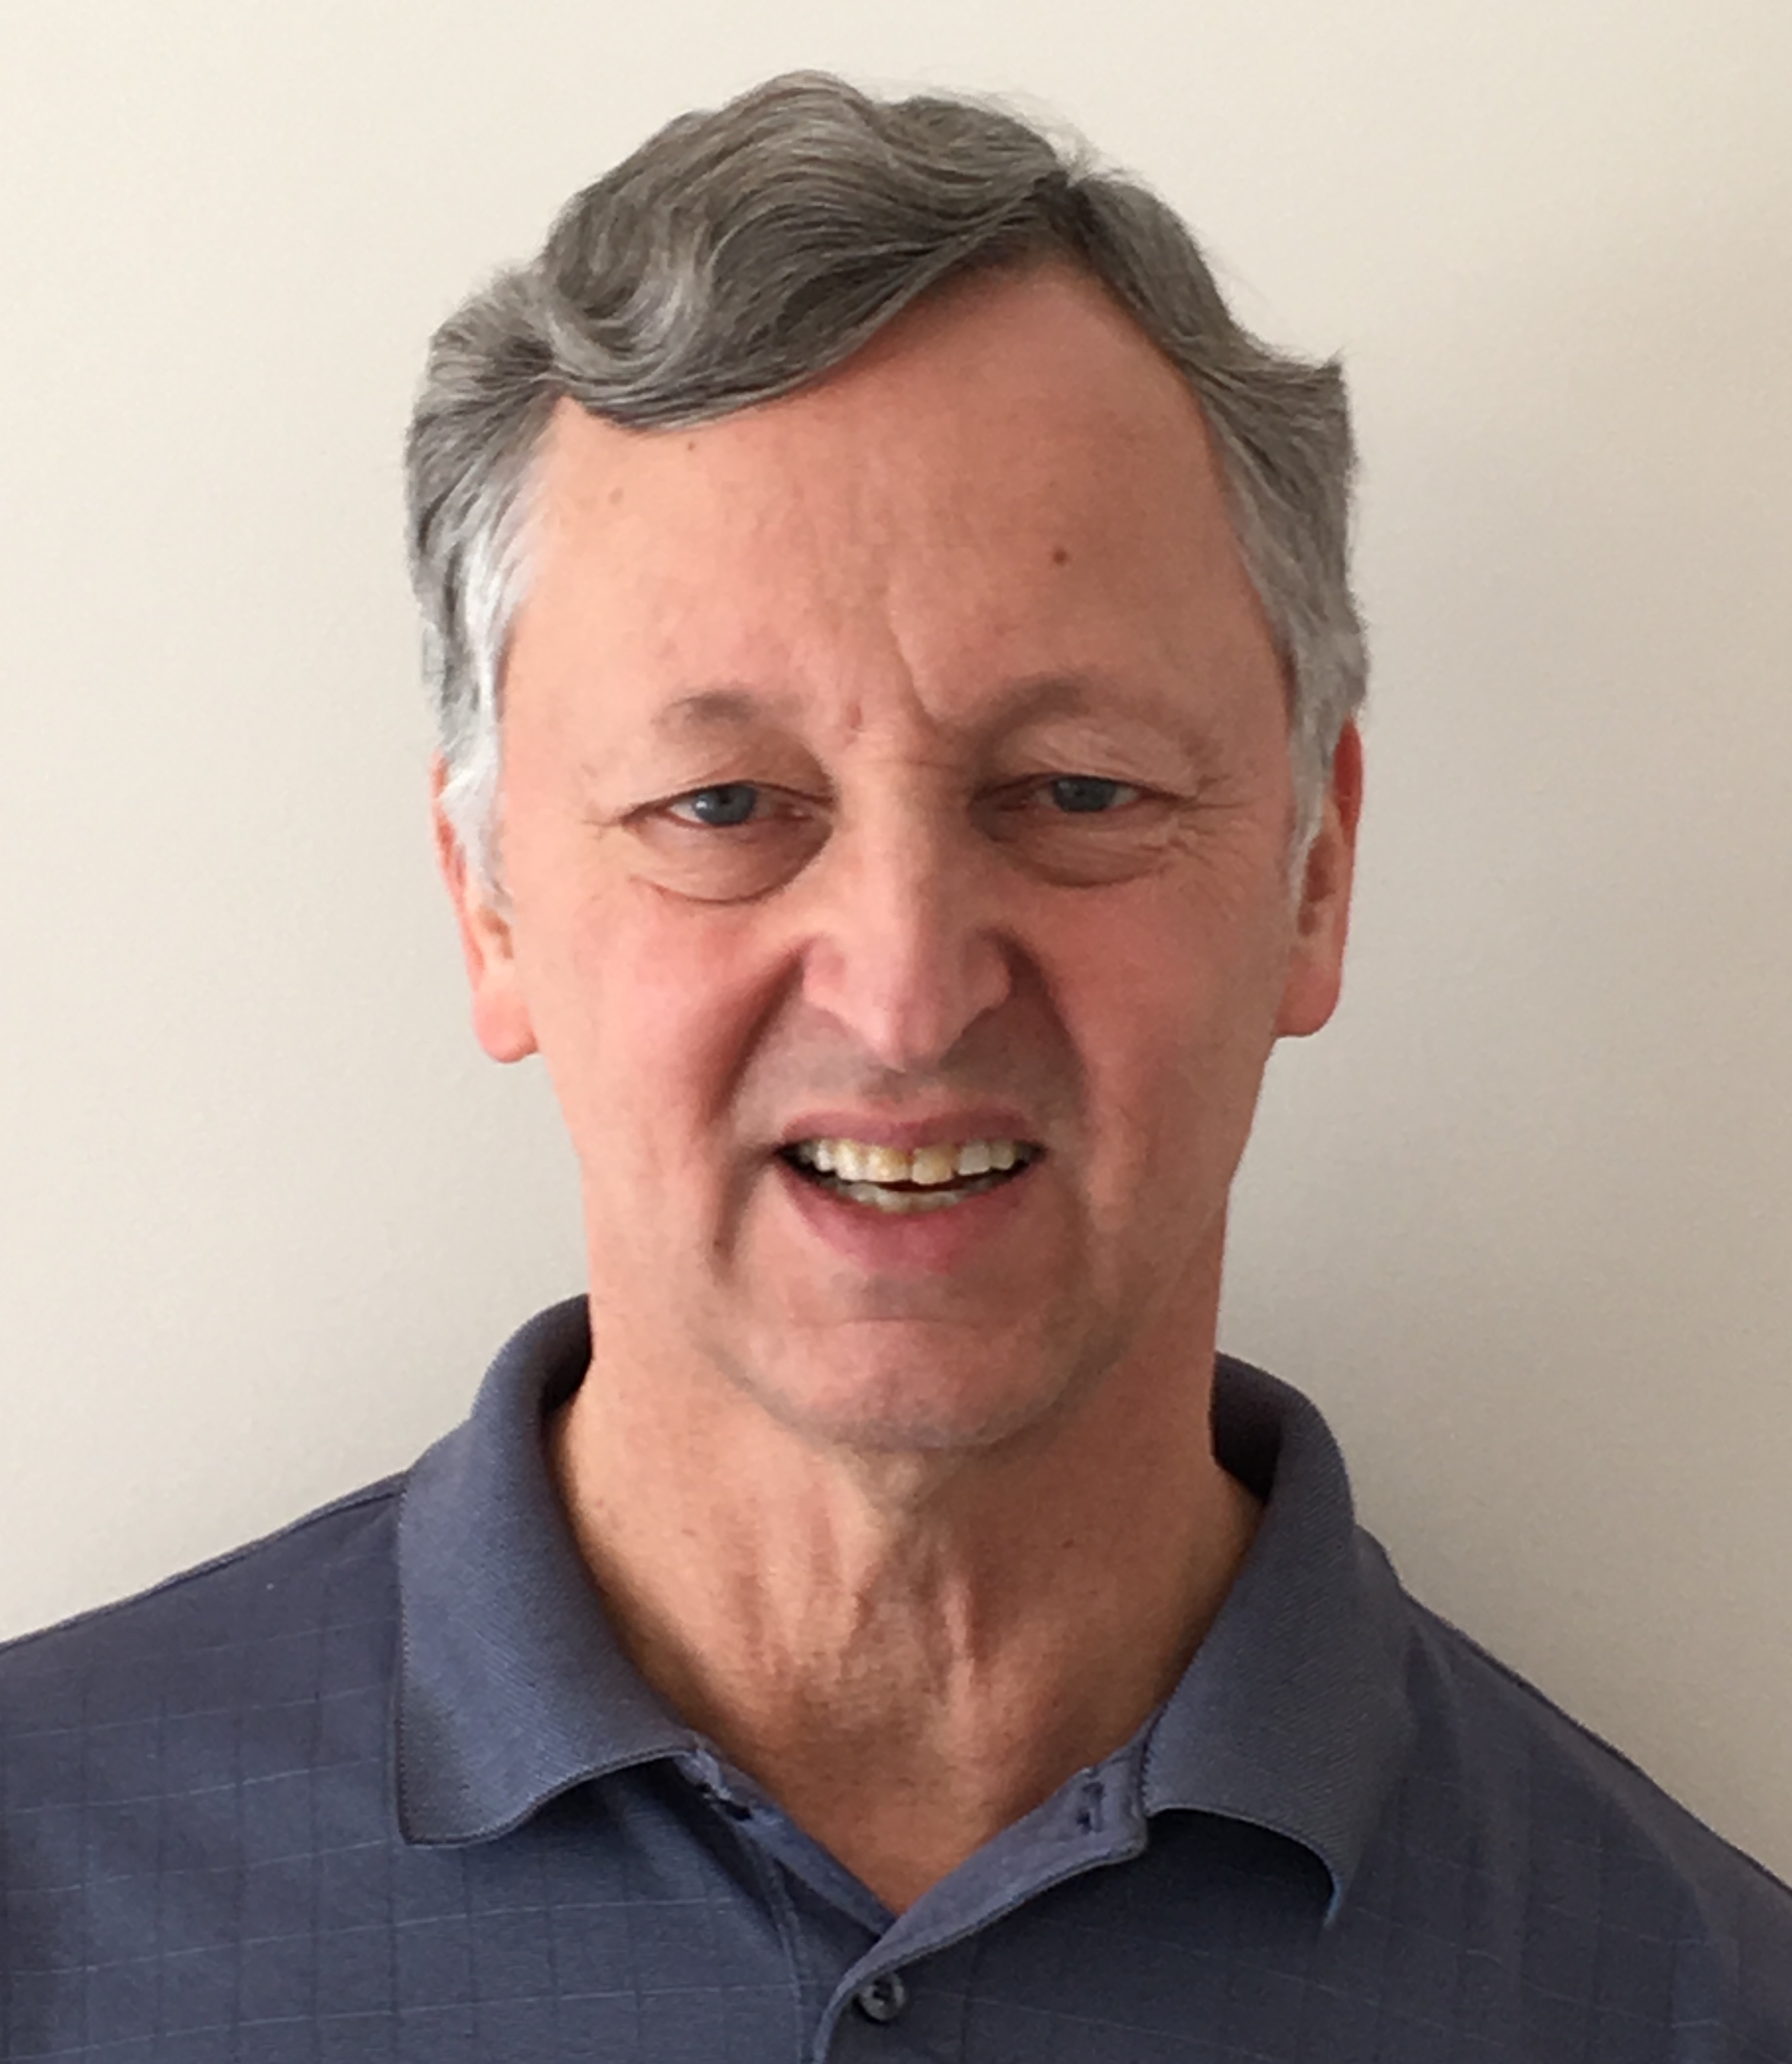
Who am I?
Name: Rob Hausam MD
Company: Hausam Consulting LLC
Background:
Co-chair of Terminology Infrastructure (TI) (formerly Vocabulary) and Orders and Observations (OO) WGs
FHIR specification and Terminology Module editor
Actively involved in HL7 and terminology standards/development and modeling for 23+ years
SNOMED on FHIR project co-lead (joint project of HL7 and SNOMED International)

Slide 4

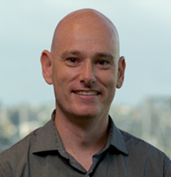
But credit is really due here…
Jim Steel
Senior Software Engineer, Health Data & FHIR CSIRO Australian e-Health Research Centre
Software Engineer on Ontoserver
Dion McMurtrie
Team Lead, FHIR and Terminology Tooling
CSIRO Australian e-Health Research Centre

Slide 5
What we will cover today
Follow some coded data through a journey, including
How the codes get found in the first place
What they look like on the wire
How they get validated on receipt
How they get queried
And maybe a few side trips …
Code system supplements, implicit value sets, ECL, composing concept maps, ? …
Images from Project Gutenberg http://www.gutenberg.org/ebooks/43936

Slide 6
FHIR Terminology resources
Concept Map
A (one way) mapping from a set of concepts to one or more other concepts
$lookup $validate-code $subsumes
Source
Target
N
N
Value Set
A selection of a set of codes for use in a particular context
Value Set
A selection of a set of codes for use in a particular context
Selects
from
Selects
from
N
Code System
A set of concepts with a coherent meaning
url, version, name, …
Filters, Properties
Concepts
Code
Display
Definition
src | rel | tgt
N
Code System
A set of concepts with a coherent meaning
url, version, name, …
Filters, Properties
Concepts
Code
Display
Definition
$expand $validate-code
$translate $closure

Slide 7


Terminology API in a FHIR Architecture
As part of a standard FHIR server
Simple, easy for clients
Separate terminology server
Single source of truth for multiple FHIR systems
Both servers behind a facade
Simple and single source of truth
FHIR server integrated with a terminology server
Simple and single source of truth
FHIR server can support terminology-aware search, validation
App
FHIR Server

Slide 8




Terminology API in a FHIR Architecture
As part of a standard FHIR server
Simple, easy for clients
Separate terminology server
Single source of truth for multiple FHIR systems
Both servers behind a facade
Simple and single source of truth
FHIR server integrated with a terminology server
Simple and single source of truth
FHIR server can support terminology-aware search, validation
App
FHIR Server
FHIR Terminology
Server

Slide 9

Terminology API in a FHIR Architecture
As part of a standard FHIR server
Simple, easy for clients
Separate terminology server
Single source of truth for multiple FHIR systems
Both servers behind a facade
Simple and single source of truth
FHIR server integrated with a terminology server
Simple and single source of truth
FHIR server can support terminology-aware search, validation
App
Façade
FHIR Server
FHIR Terminology
Server

Slide 10
Terminology API in a FHIR Architecture
As part of a standard FHIR server
Simple, easy for clients
Separate terminology server
Single source of truth for multiple FHIR systems
Both servers behind a facade
Simple and single source of truth
FHIR server integrated with a terminology server
Simple and single source of truth
FHIR server can support terminology-aware search, validation
App
FHIR Server
FHIR Terminology
Server
FHIR Server

Slide 11
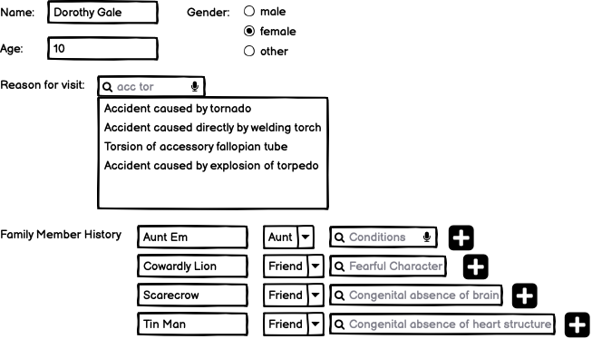
Step 1: Dorothy makes an appointment with Dr Oz

Slide 12
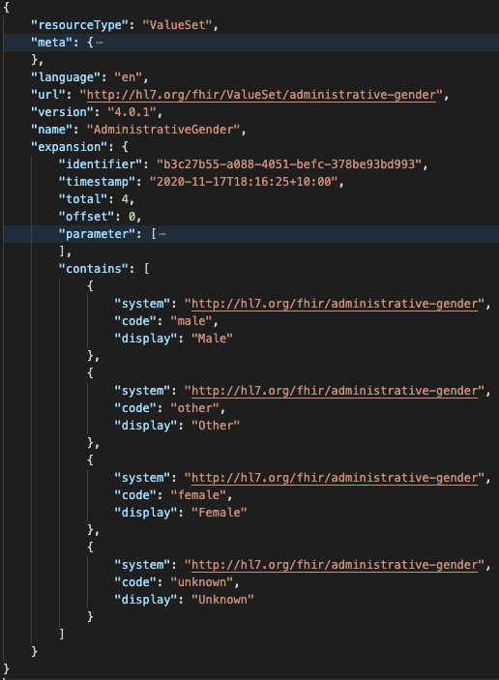
Get gender options
GET ValueSet/$expand? url= http://hl7.org/fhir/ValueSet/administrative-gender

Slide 13
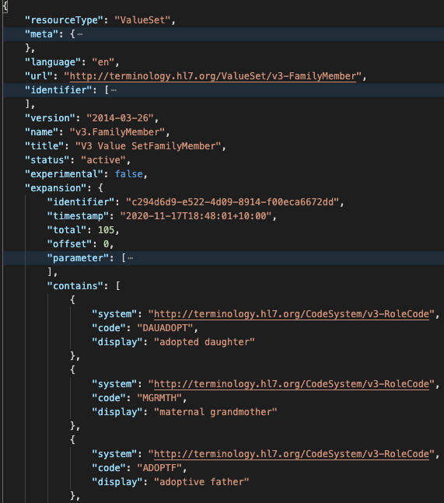
Get Family Member Relationships
GET ValueSet/$expand?context=FamilyMemberHistory.relationship

Slide 14
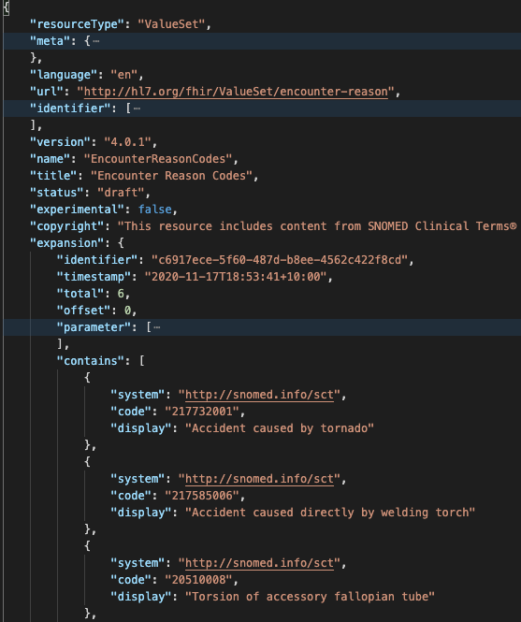
Search for reason for visit
GET ValueSet/$expand? context=Encounter.reasonCode& filter=acc tor

Slide 15
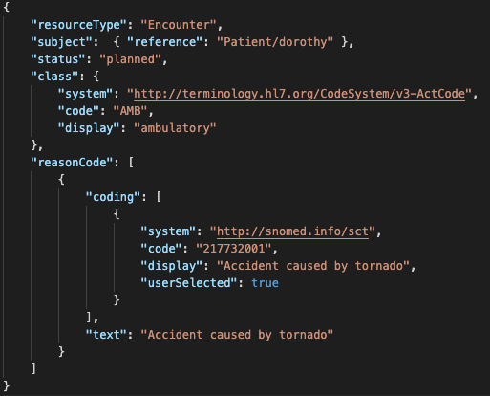
Coded data instances
code
Coding
CodeableConcept

Slide 16
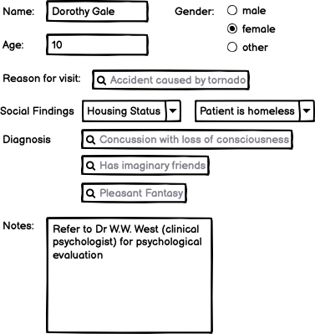
Step 2. Dr Oz makes his record

Slide 17
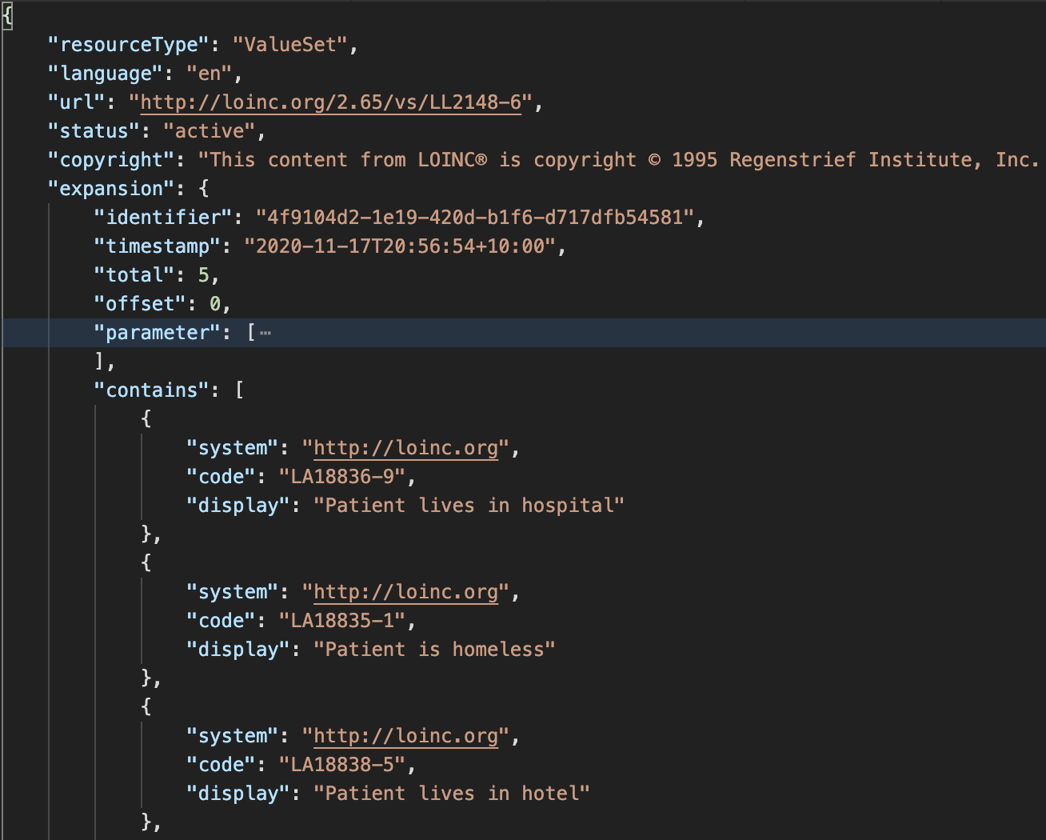
Selecting housing status
GET /ValueSet/$expand?url=http://loinc.org/vs/LL2148-6

Slide 18
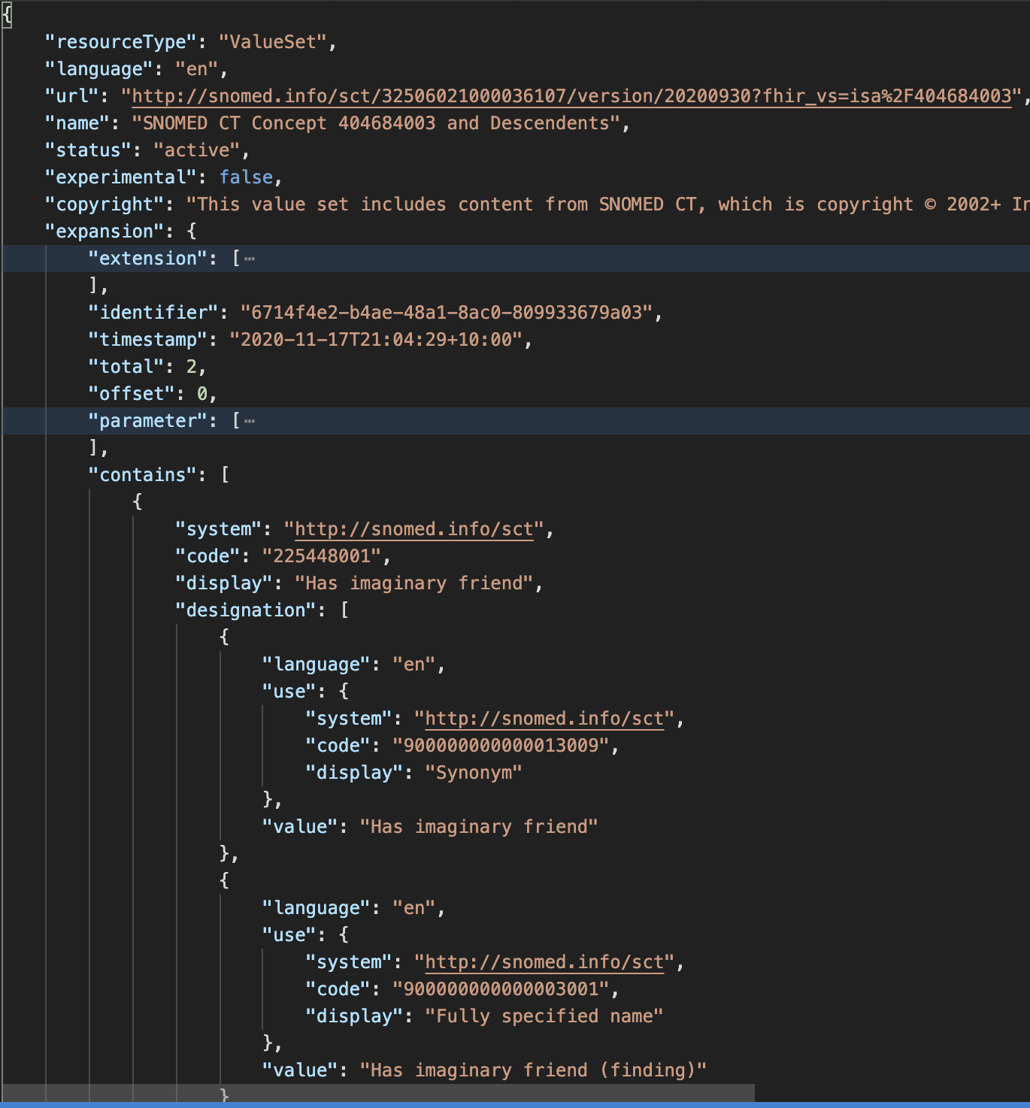
Selecting diagnosis codes
GET /ValueSet/$expand? url=http://snomed.info/sct?fhir_vs=isa/404684003& count=10& offset=0& includeDesignations=true& filter=imagina

Slide 19

Step 3. Dr Oz sends his record to Dr West
Dr West’s EMR validates the resources when they arrive
Dr West’s EMR probably enforces some profiles of Patient/Encounter/ServiceRequest/Condition/FamilyMemberHistory
FHIR $validate
Usually makes lots of calls to ValueSet/$validate-code

Slide 20
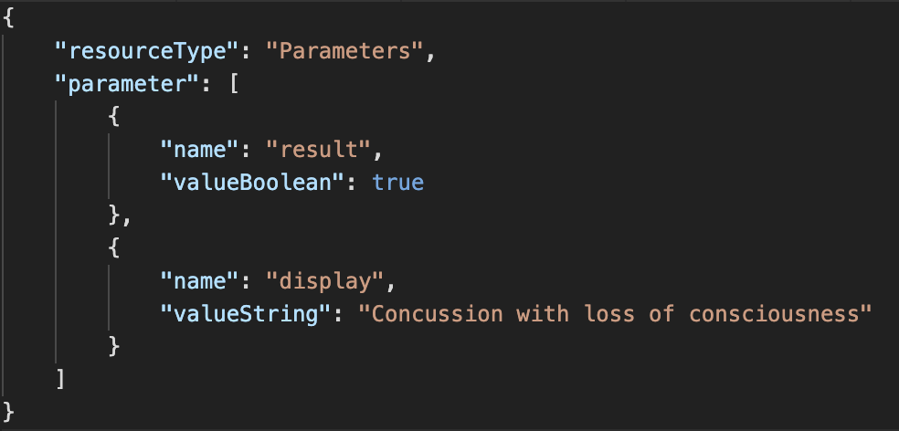
Check condition codes
GET /ValueSet/$validate-code? url=http://snomed.info/sct?fhir_vs=refset/32570071000036102& system=http://snomed.info/sct& code=62564004

Slide 21
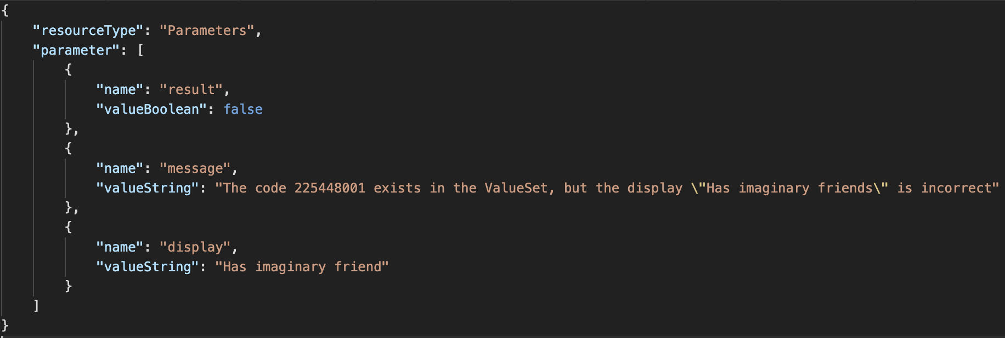
Check condition codes
GET /ValueSet/$validate-code? url=http://snomed.info/sct?fhir_vs=refset/32570071000036102& system=http://snomed.info/sct& code= 225448001& display=Has imaginary friends

Slide 22
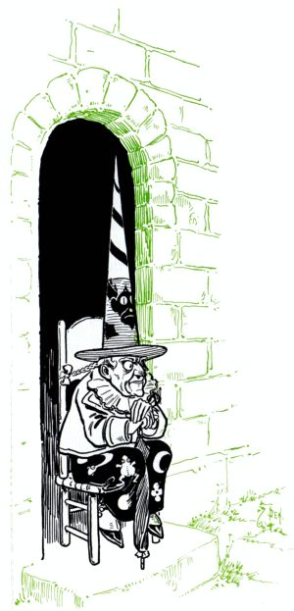
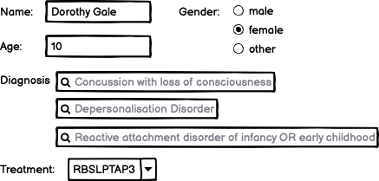
Step 4. Dr West completes her record

Slide 23
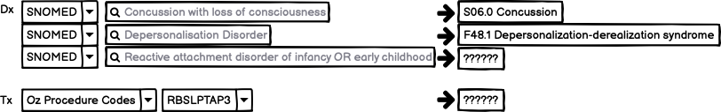
Step 5. Dr West submits her record to the HIE

Slide 24
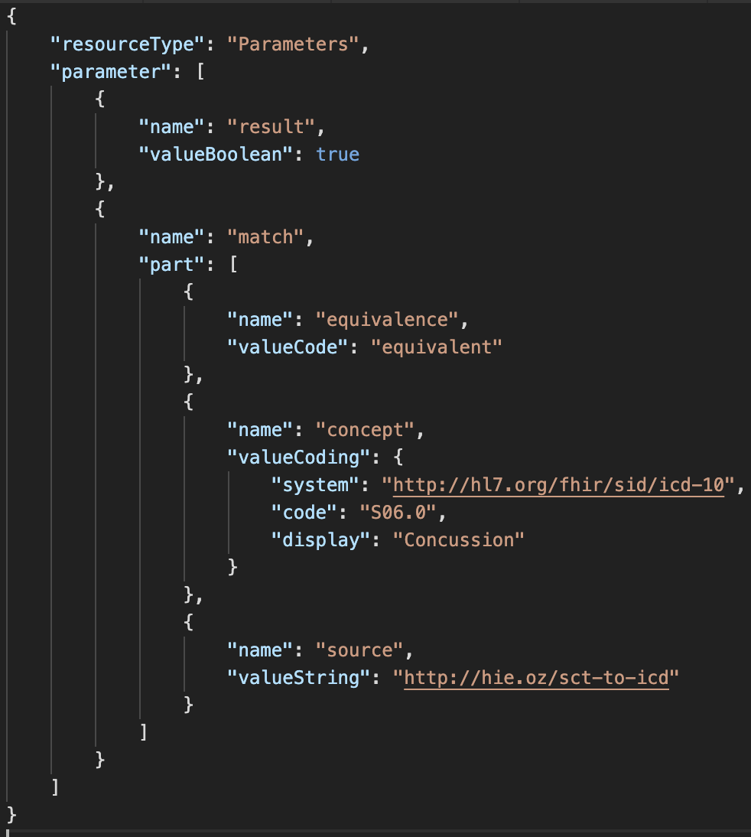
Map SNOMED codes to ICD-10 (using some ConceptMap)
GET /ConceptMap/$translate? url=http://hie.oz/sct-to-icd& target=http://hl7.org/fhir/sid/icd-10/vs& system=http://snomed.info/sct& code=62564004

Slide 25
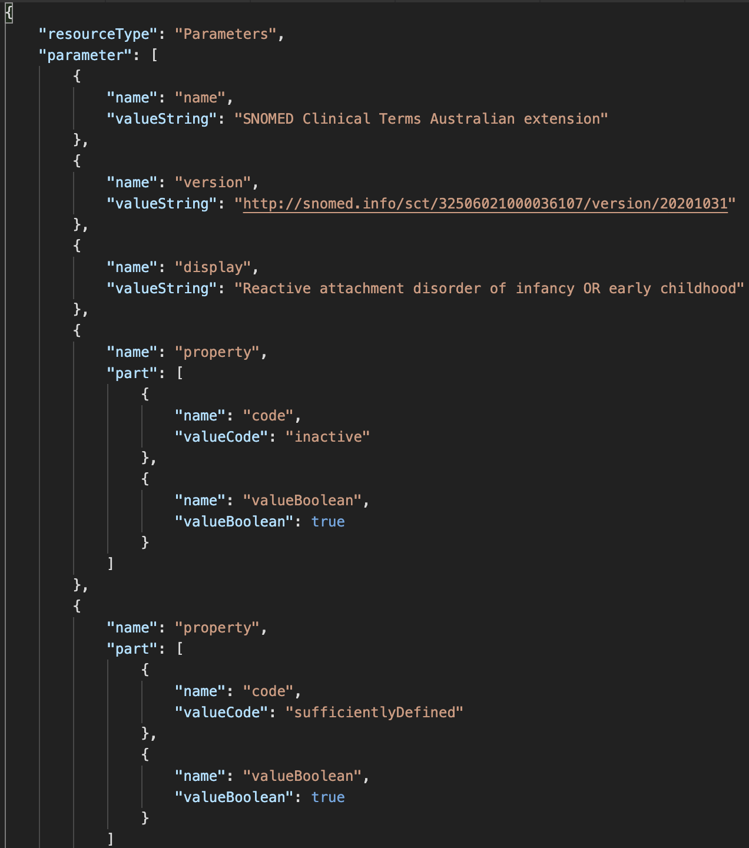
What about that unmapped code?
GET /CodeSystem/$lookup? system=http://snomed.info/sct& code=28857002

Slide 26
What if …
Another concept map is available that includes the unmapped concept?

Slide 27
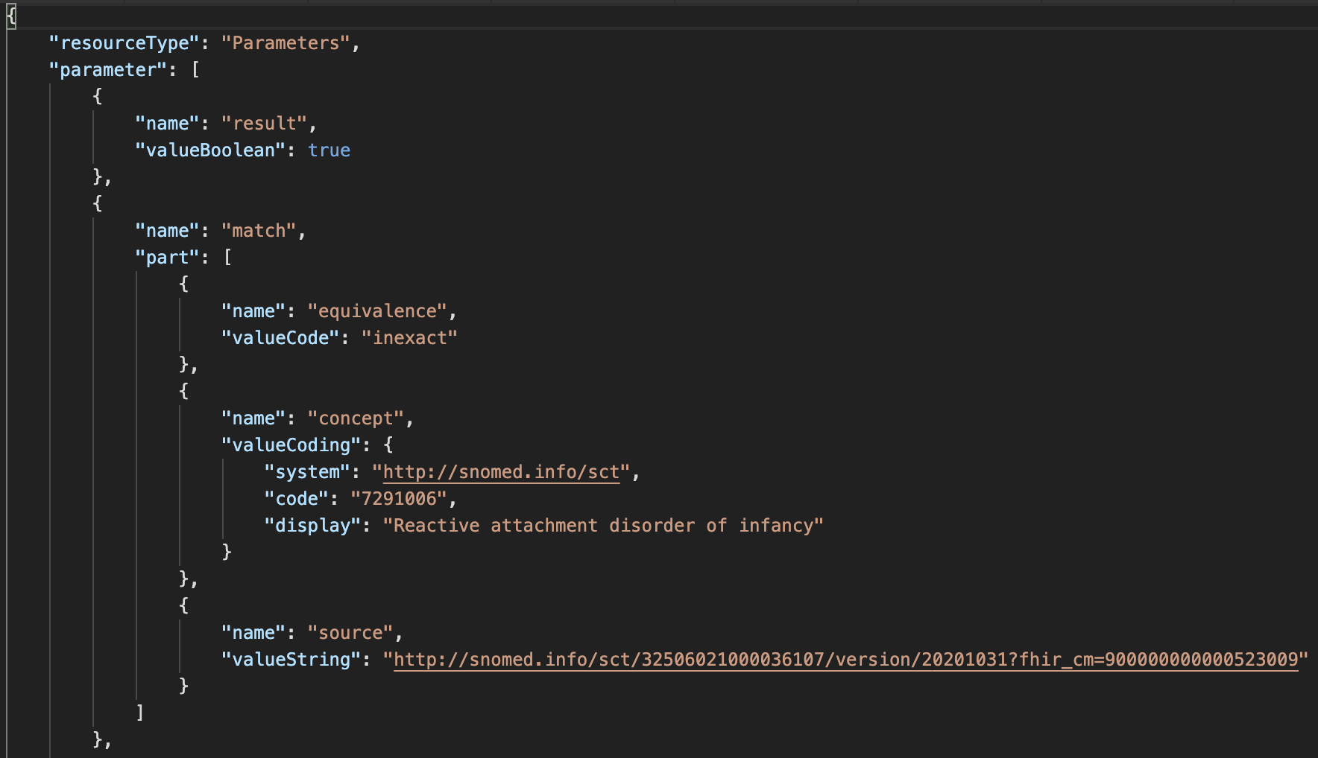
What was this inactive SNOMED CT code replaced by?
GET /ConceptMap/$translate? url=http://snomed.info/sct?fhir_cm=900000000000523009& target=http://snomed.info/sct?fhir_vs& system=http://snomed.info/sct& code=28857002

Slide 28
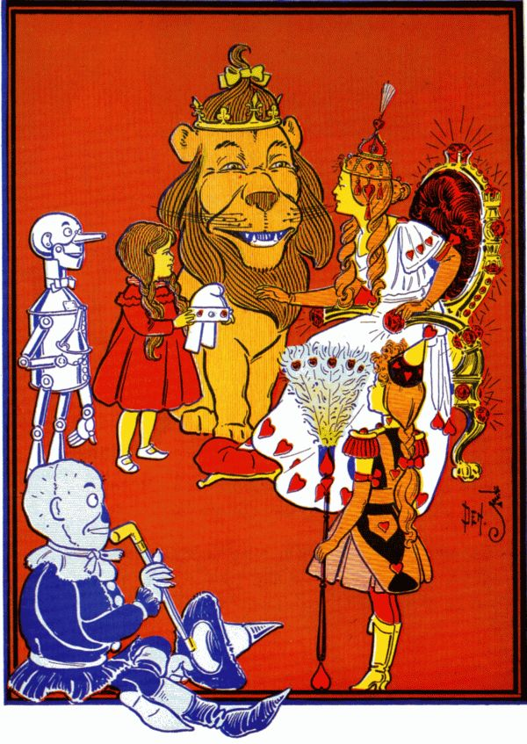
Step 6. Glinda Goodwitch is doing some analytics
She wants to find what treatment paths are being used for patients with mental health conditions
She starts with all SCT Mental Illnesses
http://snomed.info/sct?fhir_vs=isa/74732009

Slide 29
Step 7. Glinda refines her cohort
She’s finding too many drunken munchkins
She’s also not interested in intellectual disabilities for this study, so …
Glinda makes her own ValueSet!

Slide 30
Making a ValueSet compose
We have 4 “building blocks” criteria
a whole code system
members of another ValueSet
specific codes from a code system
a filter (property, op, value)
Multiple criteria in the same include/exclude
AND/intersection
E.g. Only members of an included ValueSet that satisfy a filter
Multiple separate include/excludes
OR/union
E.g. members of an included ValueSet as well as codes that satisfy a filter
All includes are processed before excludes

Slide 31
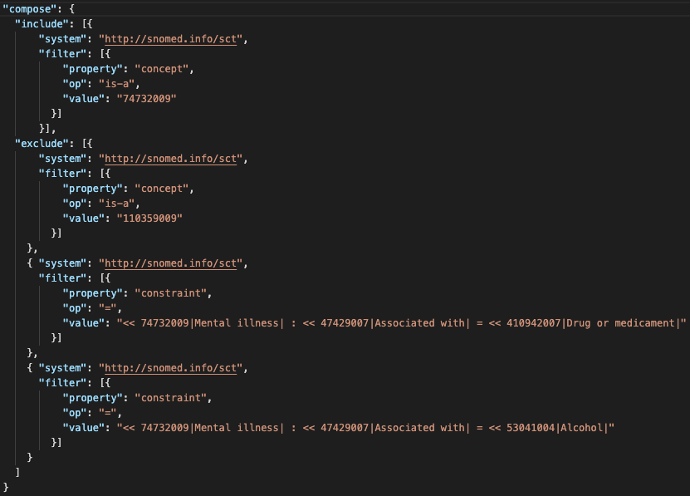

Slide 32
What if …
You would like to rapidly create and test new (refined) value set(s)?

Slide 33
What if …
You need to add translations in a different langauge?

Slide 34
Glinda’s FHIR server
/Patient?_has:Condition:subject:code:below=74732009
Maybe Glinda’s server is using $closure to keep a local cache of subsumption relationships among the codes it knows about.
Maybe Glinda’s server has some virtualized tables that sync with the terminology server periodically
/Patient?_has:Condition:subject:code:in=http://hie.oz/mental-health
Unfortunately there is no $closure equivalent for ValueSet membership
If the server is limited to only known ValueSet urls, then maybe it maintains a cache. Otherwise, maybe it just asks the server (e.g. for the intersection of the ValueSet and the server’s known Condition codes)

Slide 35
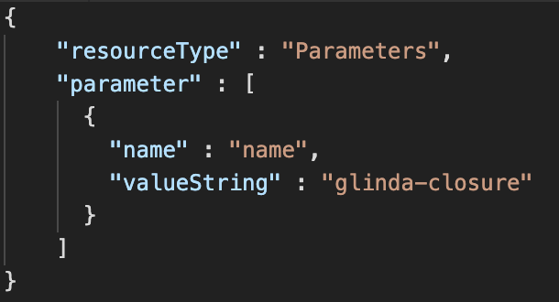
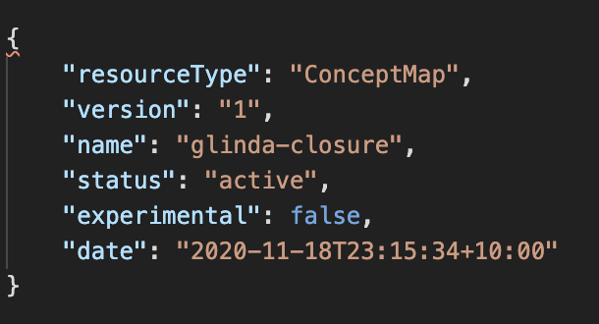
$closure (1/3)

Slide 36
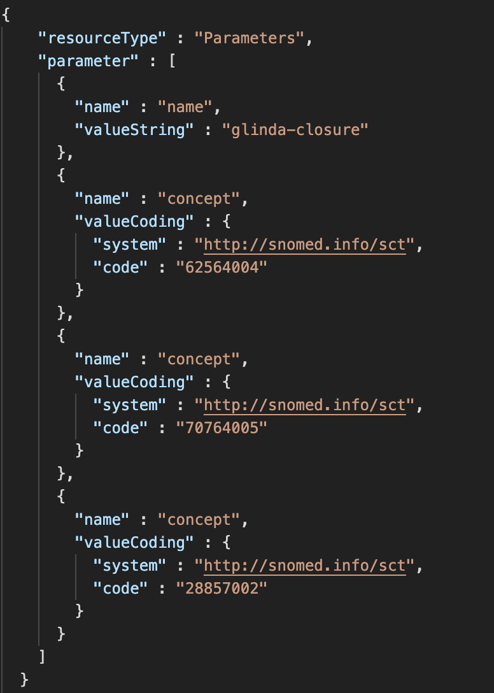
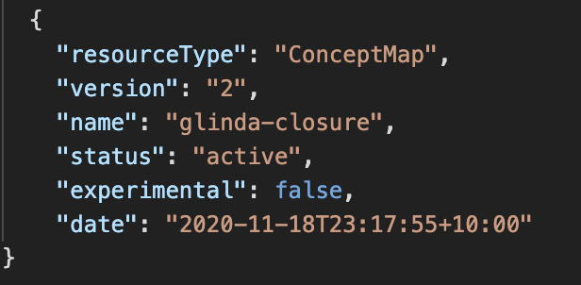
$closure (2/3

Slide 37
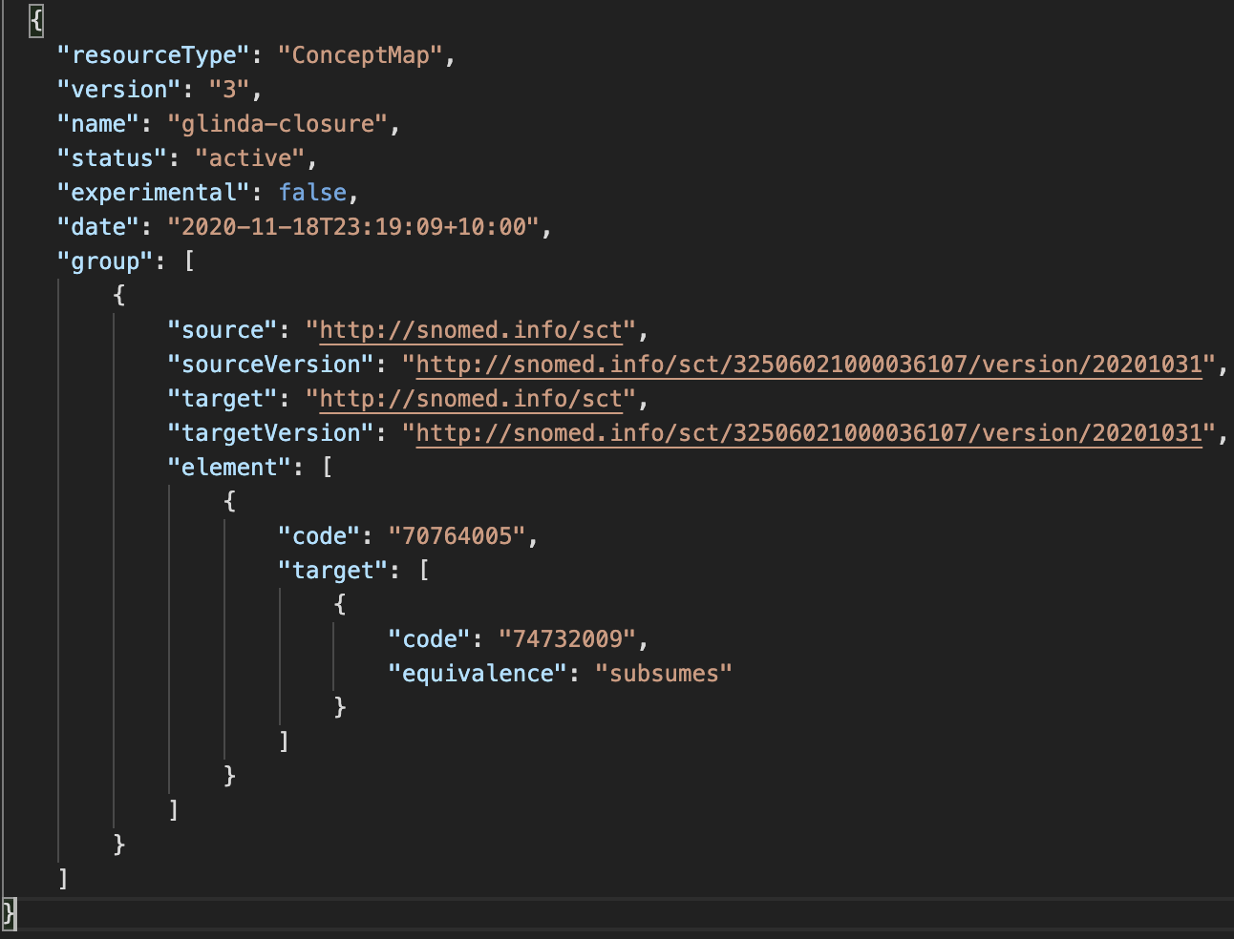
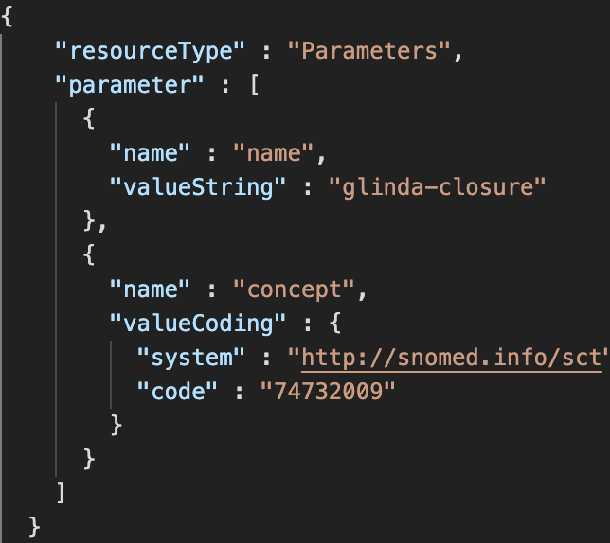
$closure (3/3)

Slide 38
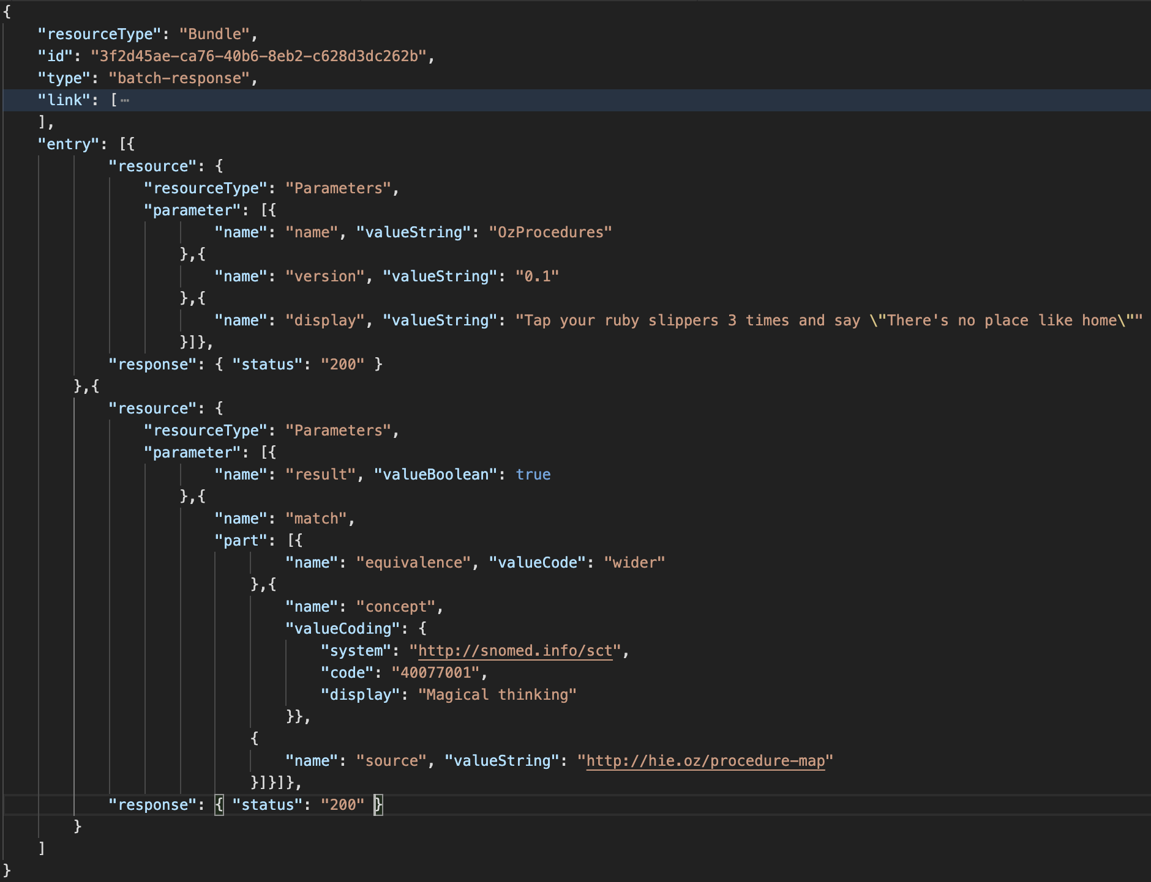
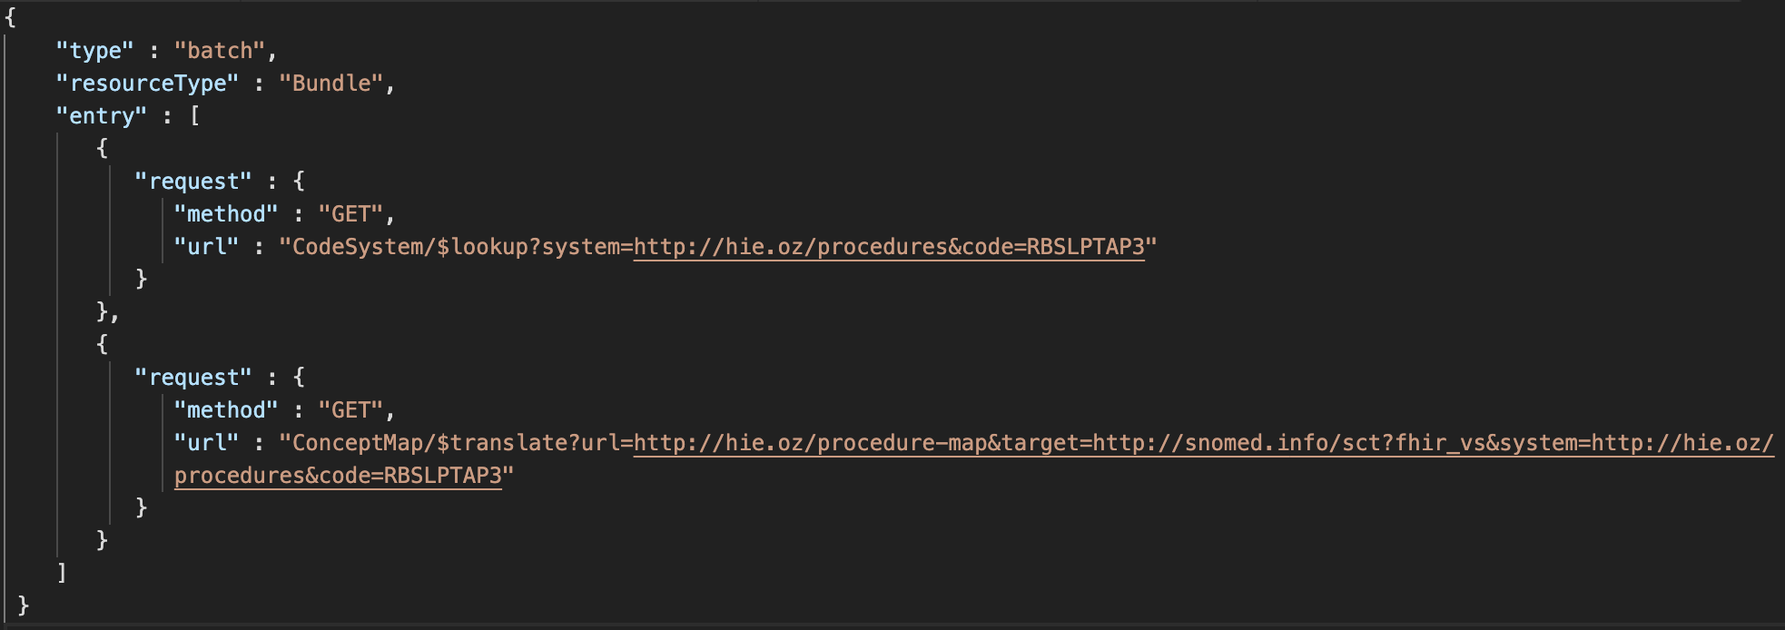
Glinda finds Dorothy!

Slide 40
What have we learned?
Some of the terminology operations in the FHIR and what they do
$expand
List all the codes in a ValueSet, or search for a code in a ValueSet
$validate-code
Test whether a code is in a ValueSet, and test whether its display text is correct
$translate
Use a ConceptMap to find what a code maps to
$lookup
Find details about a code

Slide 41
What have we learned?
A quick example of making your own ValueSet
Some hopes for integration of FHIR and terminology servers!
And some additional topics …

Slide 42
More on conceptmaps

Slide 43
ConceptMaps, context is everything
Concept Map
A (one way) mapping from a set of concepts to one or more other concepts
Source
Target
N
N
Value Set
A selection of a set of codes for use in a particular context
Value Set
A selection of a set of codes for use in a particular context
Selects
from
Selects
from
N
Code System
A set of concepts with a coherent meaning
url, version, name, …
Filters, Properties
Concepts
Code
Display
Definition
src | rel | tgt
N
Code System
A set of concepts with a coherent meaning
url, version, name, …
Filters, Properties
Concepts
Code
Display
Definition

Slide 44


But…what if I just want to tweak a big map?
You can copy and alter the map…but maintaining it?
You can compose a ConceptMap
Provide specific new/overridden mappings
Delegate to another map for everything else
Base map
New maps /
overrides
Initial request
Delegated where not
overridden

Slide 45
Options for “unmapped”
Delegation is via the “unmapped” section of the ConceptMap
Code | Meaning
use-source-code | Use the source code from the $translate request.
fixed | Use the code(s) explicitly provided – either as a 'code' or 'valueSet' element.
other-map | Use the map identified by the canonical URL in the url element.

Slide 46
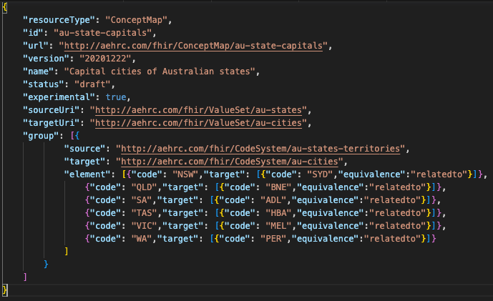

Example – create the base map

Slide 47
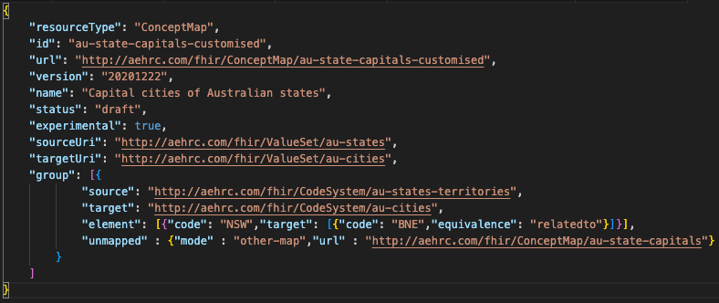
Example – create the custom map

Slide 48
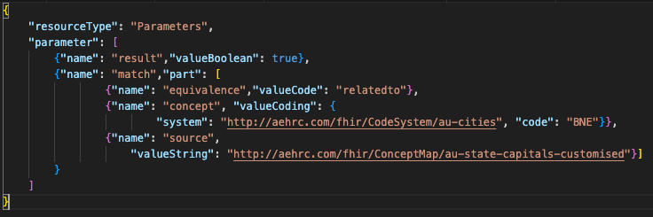
Example – use $translate on the custom map
https://r4.ontoserver.csiro.au/fhir/ConceptMap/$translate?
url=http://aehrc.com/fhir/ConceptMap/au-state-capitals-customized
&system=http://aehrc.com/fhir/CodeSystem/au-states-territories
&code=NSW
&target=http://aehrc.com/fhir/ValueSet/au-cities
Clear where the mapping came from

Slide 49
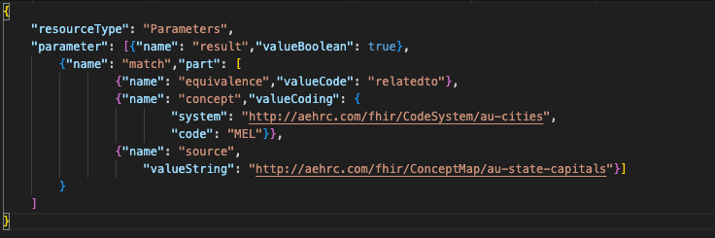
Example – other translations are delegated
https://r4.ontoserver.csiro.au/fhir/ConceptMap/$translate?
url=http://aehrc.com/fhir/ConceptMap/au-state-capitals-customized
&system=http://aehrc.com/fhir/CodeSystem/au-states-territories
&code=VIC
&target=http://aehrc.com/fhir/ValueSet/au-cities
Clear where the mapping came from

Slide 50
Implicit value sets and ecl

Slide 51
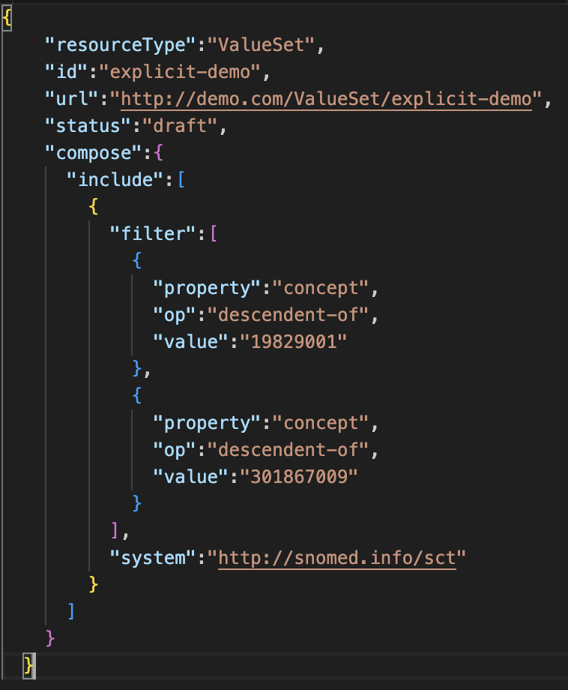
Let’s query a CodeSystem
I want to know all the SNOMED CT codes that are both
Oedema of trunk, AND
Disorder of lung
First, we need to make a ValueSet
Then POST it to the server

Slide 52
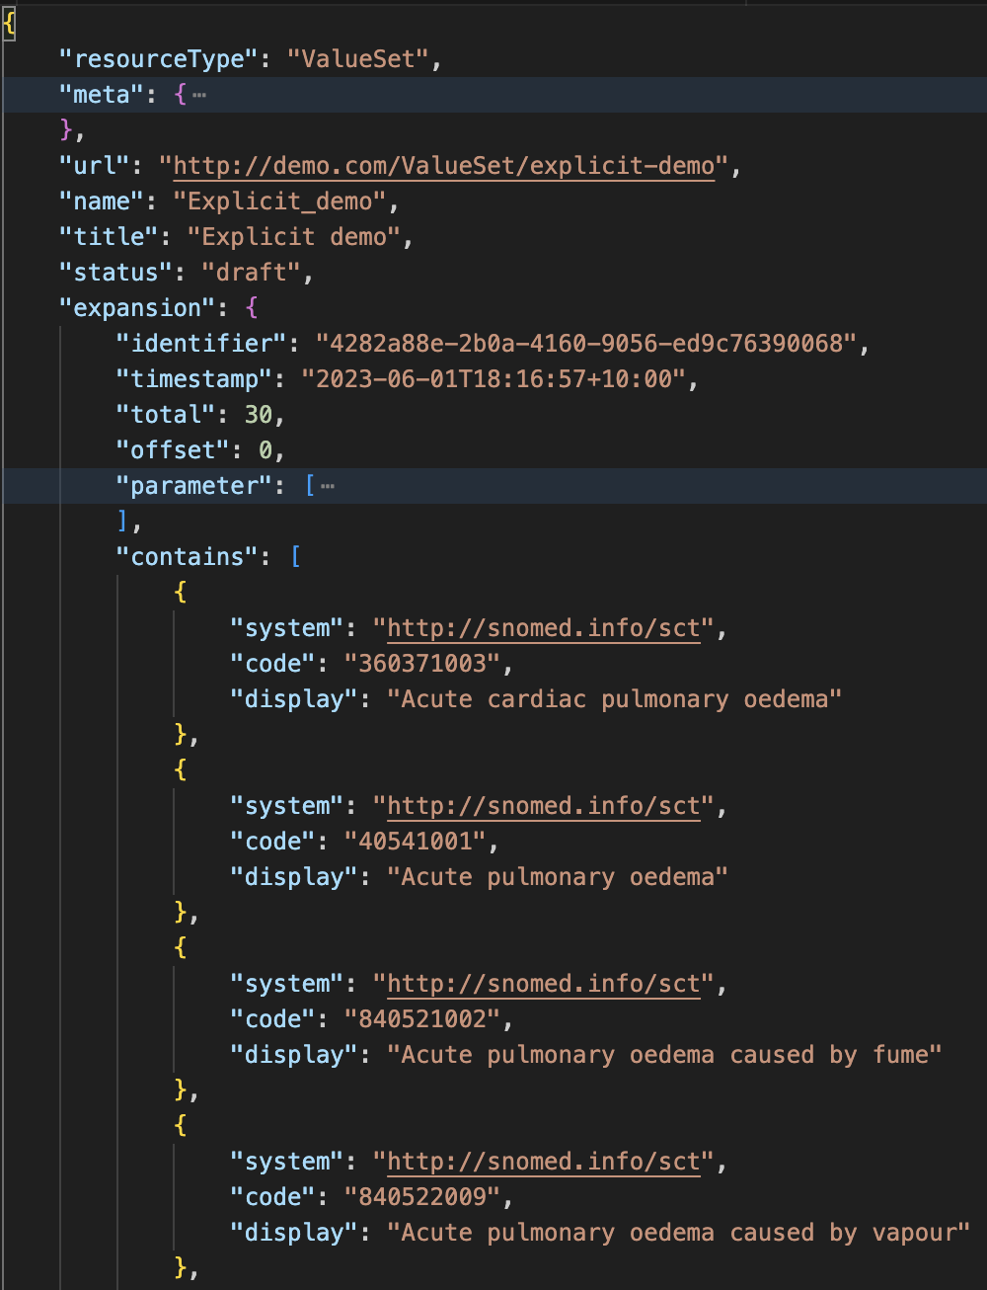
Now we can $expand it
curl --location 'https://r4.ontoserver.csiro.au/fhir/ValueSet/explicit-demo/$expand’
But now I want to know the lung disorders that aren’t oedemas…
I have to
update the ValueSet,
PUT it
$expand again

Slide 53
There is a shortcut – POST a ValueSet to $expand
curl --location 'https://r4.ontoserver.csiro.au/fhir/ValueSet/$expand' --header 'Content-Type: application/fhir+json’ --data
'{"resourceType":"Parameters",
"parameter":[ {
"name":"valueSet",
"resource":{"resourceType":"ValueSet",
"compose":{
"include":[{"filter":[{"property":"concept","op":"descendent-of","value":"19829001"}],
"system":"http://snomed.info/sct"}],
"exclude": [{"filter":[{"property":"concept","op":"descendent-of","value":"301867009"}],
"system":"http://snomed.info/sct"}]}}}]}'
Still a bit tedious
POST request – doesn’t cache

Slide 54
Implicit ValueSets to the rescue
Instead of creating a ValueSet resource, $expand a “special” URI
Defined for SNOMED CT, LOINC, RxNorm, and UCUM
https://terminology.hl7.org/SNOMEDCT.html#snomed-ct-implicit-value-sets
?fhir_vs | all concept ids in the edition/version.
?fhir_vs=isa/[sctid] | all concept ids that are subsumed by the specified concept.
?fhir_vs=refset | all concept ids that correspond to reference sets that are explicitly defined in the specified SNOMED CT edition
?fhir_vs=refset/[sctid] | all concept ids in the specified reference set
?fhir_vs=ecl/[ecl] | all concept ids that match the supplied (URI-encoded) expression constraint
curl --location 'https://r4.ontoserver.csiro.au/fhir/ValueSet/$expand
?url=http://snomed.info/sct?fhir_vs=isa/19829001'

Slide 55
SNOMED CT ECL – a super brief overview
Set of conditions used to find matching concepts/expressions
Descendant of | < 404684003 |Clinical finding|
Descendant or Self of | << 73211009 |Diabetes mellitus|
Child of | <! 404684003 |Clinical finding|
Child or Self of | <<! 404684003 |Clinical finding|
Ancestor of | > 40541001 |Acute pulmonary edema|
Ancestor or Self of | >> 40541001 |Acute pulmonary edema|
Parent of | >! 40541001 |Acute pulmonary edema|
Parent or Self of | >>! 40541001 |Acute pulmonary edema|
Member of | ^ 700043003 |Example problem list concepts reference set|

Slide 56
SNOMED CT ECL – a super brief overview
Includes syntax for attributes
Attributes | < 19829001 |Disorder of lung| : 116676008 |Associated morphology| = 79654002 |Edema| < 404684003 |Clinical finding| : 363698007 |Finding site| = << 39057004 |Pulmonary valve structure| , 116676008 |Associated morphology| = << 415582006 |Stenosis|
Attribute Groups | < 404684003 |Clinical finding| : { 363698007 |Finding site| = << 39057004 |Pulmonary valve structure| , 116676008 |Associated morphology| = << 415582006 |Stenosis| }, { 363698007 |Finding site| = << 53085002 |Right ventricular structure| , 116676008 |Associated morphology| = << 56246009 |Hypertrophy| }
Attribute constrains | << 404684003 |Clinical finding| : << 47429007 |Associated with| = << 267038008 |Edema|

Slide 57
SNOMED CT ECL – a super brief overview
…and much more…
Concrete values | < 763158003 |Medicinal product (product)| : 411116001 |Has manufactured dose form (attribute)| = << 385268001 |Oral dose form (dose form)| , { << 127489000 |Has active ingredient (attribute)| = << 372687004 |Amoxicillin (substance)| , 1142135004 |Has presentation strength numerator value (attribute)| >= #250, 1142135004 |Has presentation strength numerator value (attribute)| <= #800, 732945000 |Has presentation strength numerator unit (attribute)| = 258684004 |milligram (qualifier value)| }
Attribute Groups | < 125605004 |Fracture of bone| . 363698007 |Finding site|
Cardinality | < 373873005 |Pharmaceutical / biologic product| : [1..3] 127489000 |Has active ingredient| = < 105590001 |Substance|
Operators | < 19829001 |Disorder of lung| AND (< 301867009 |Edema of trunk| OR ^ 700043003 |Example problem list concepts reference set| )

Slide 58
Some thoughts on ECL implicit ValueSets
No need to create anything
I can simply fire requests at the server as I think of them
GET https://r4.ontoserver.csiro.au/fhir/ValueSet/$expand?
url=http://snomed.info/sct?fhir_vs=ecl/<<19829001 and <<301867009
GET https://r4.ontoserver.csiro.au/fhir/ValueSet/$expand?
url=http://snomed.info/sct?fhir_vs=ecl/<<19829001 minus <<301867009
Much more compact and agile, caches well in web caches
ECL UI builders https://ontoserver.csiro.au/shrimp/ecl
Great for adhoc queries

Slide 59
Code system supplements

Slide 60
Augmenting a CodeSystem
Heaps of CodeSystems are maintained by others – it’s great!
Many HL7 CodeSystems
Large published CodeSystems – e.g. LOINC, SNOMED CT etc.
Local/regional CodeSystems
But what if you need to…
Customise the display term for a code?
Translate a CodeSystem to another language?
Add properties to a CodeSystem’s codes?
You could ask the maintainer
probably should if it is generally useful
…but you don’t know if/when it will happen

Slide 61
This is what CodeSystem Supplements are for…
✅
Extending codes in existing CodeSystems with
Properties
Designations (including language translations)
But…do not allow addition of new codes
Used in the context of a ValueSet
Affects the $expand results
Changes returned display
Adds in available properties
❌

Slide 62
How do translations work in FHIR Terminology anyway?
The key is https://build.fhir.org/languages.html
For the requestor, it’s just HTTP
There’s also the displayLanguage parameter if headers are a problem
Request header | Accept-Language: de-DE
Response header | Content-Language: en-US

Slide 63
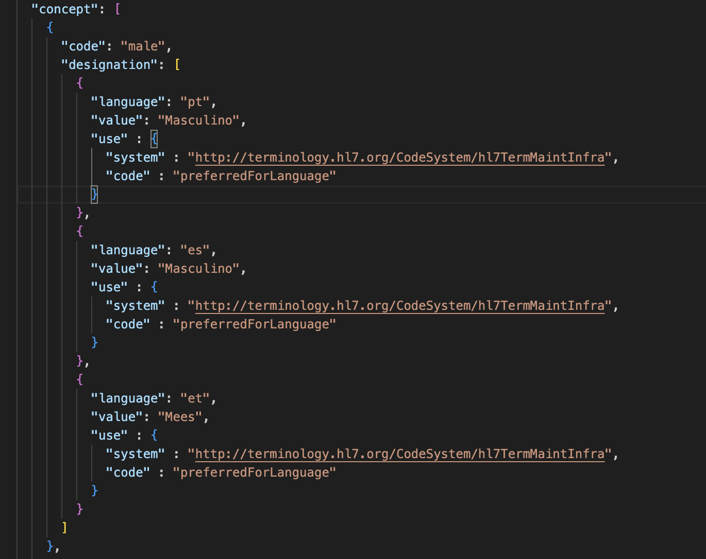
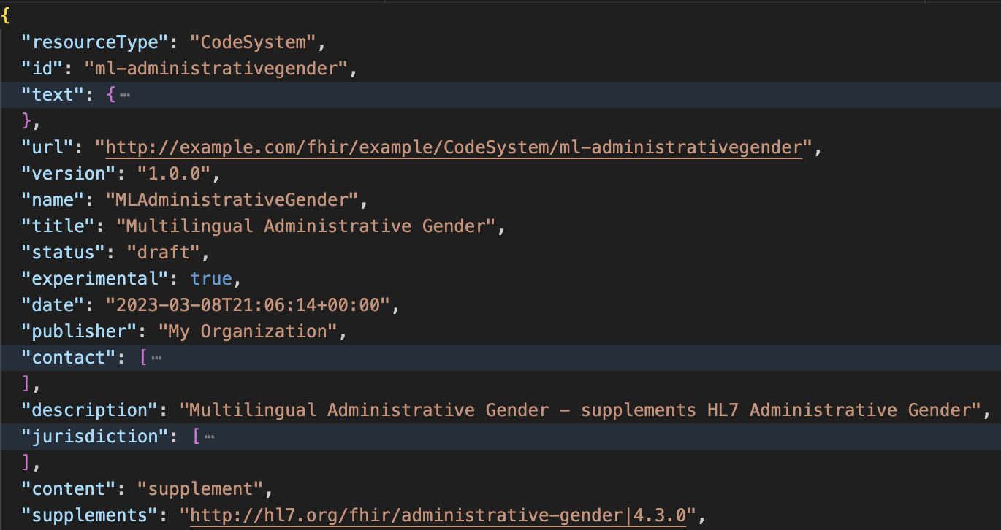
Adding a translation to a CodeSystem

Slide 64
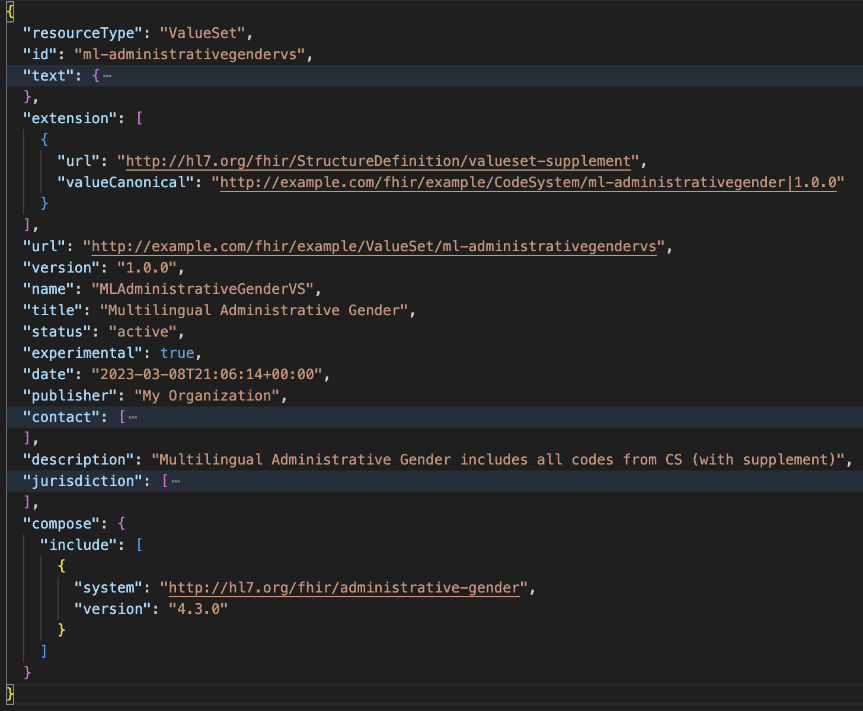
We need a ValueSet that uses the supplement
New R5 parameter
useSupplement

Slide 65
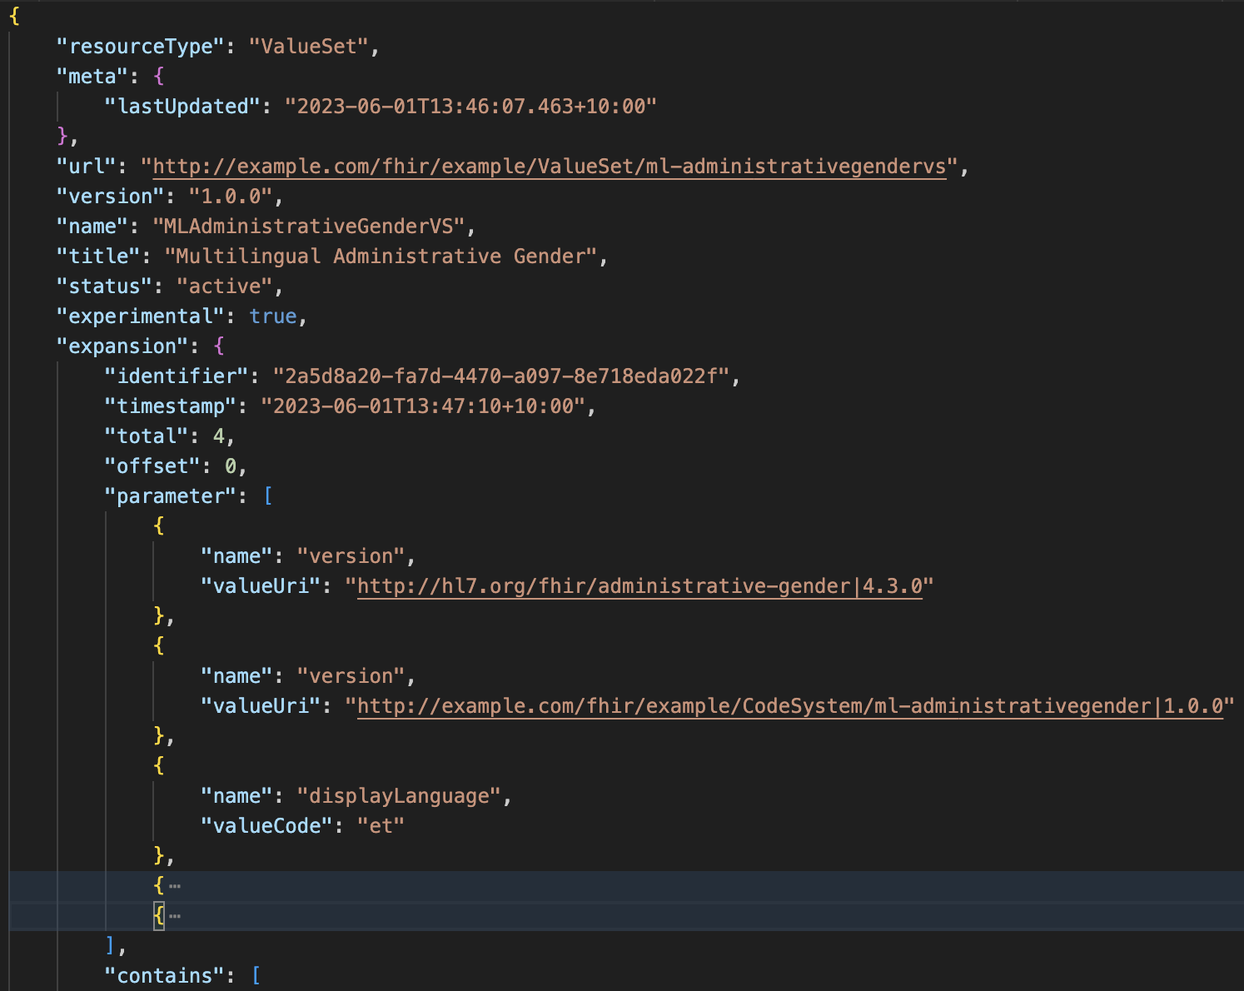
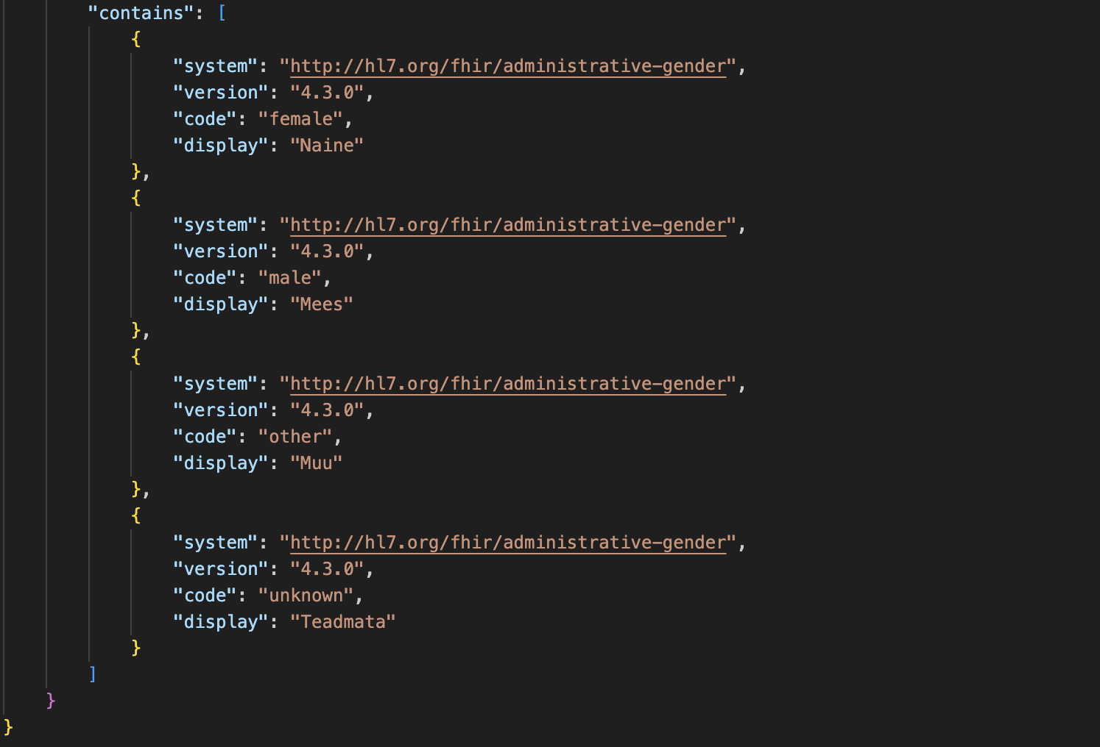
Using our translation supplement
curl --location 'https://r4.ontoserver.csiro.au/fhir/ValueSet/ml-administrativegendervs/$expand’ \
--header 'Accept-Language: et'

Slide 66
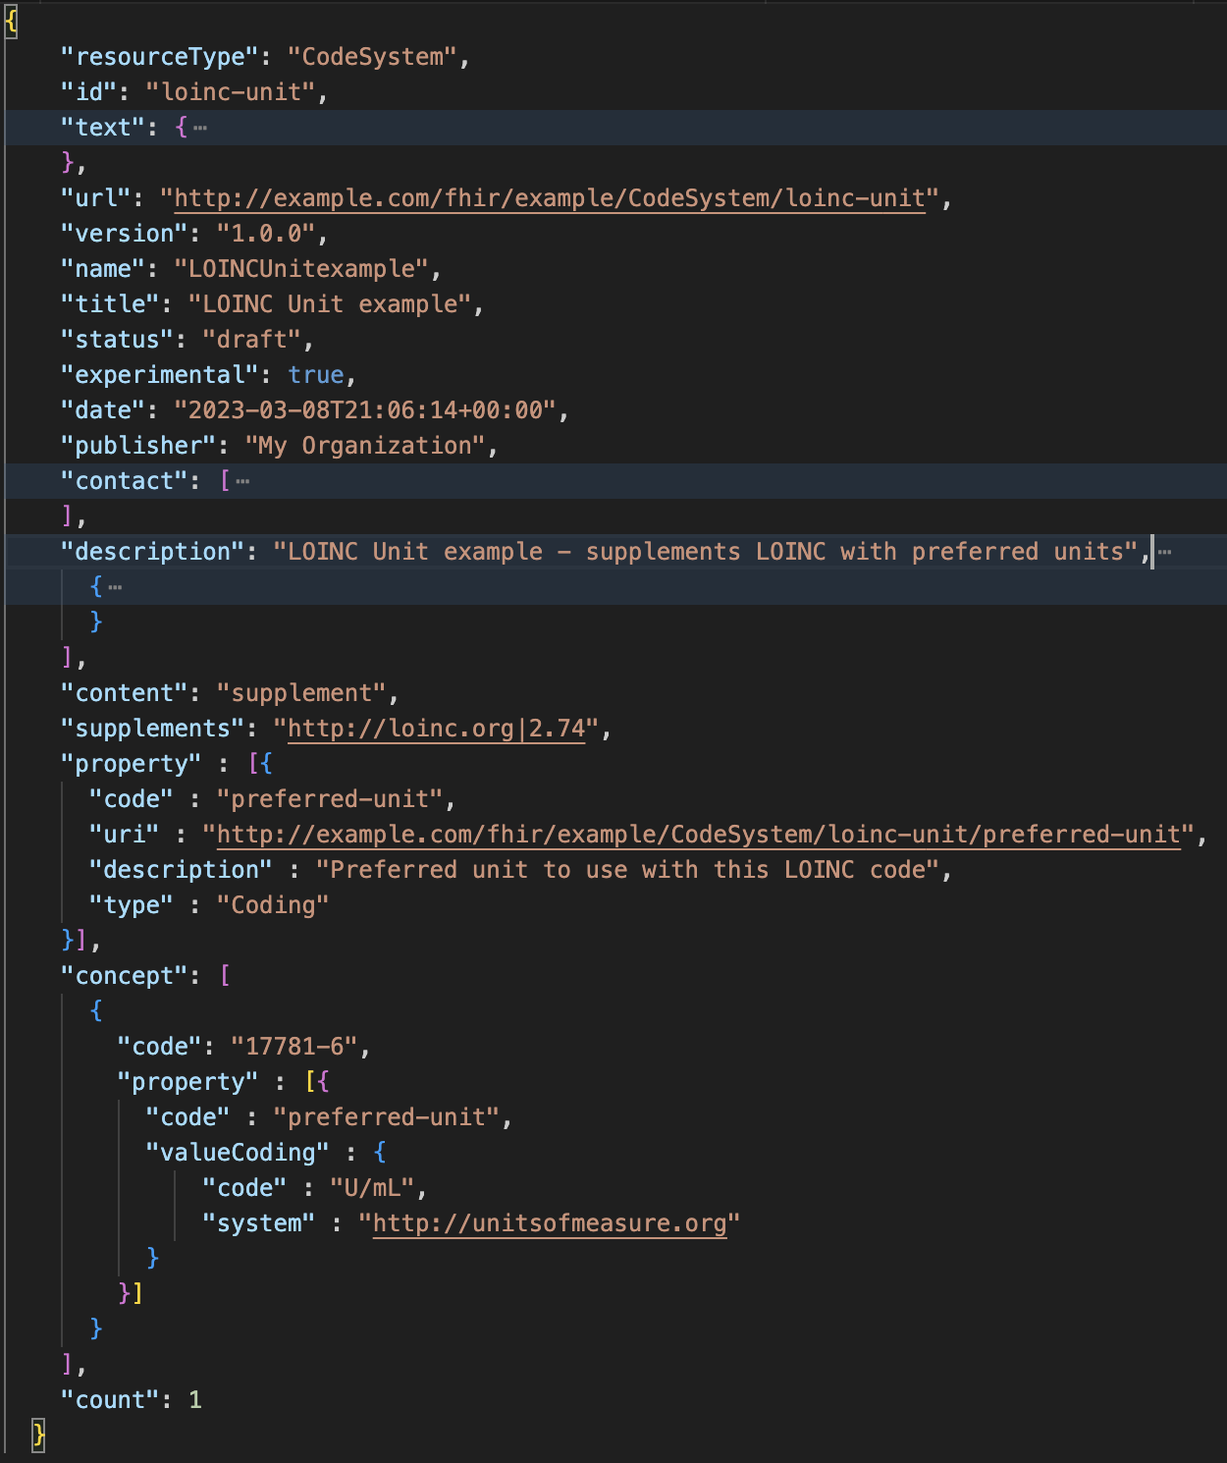
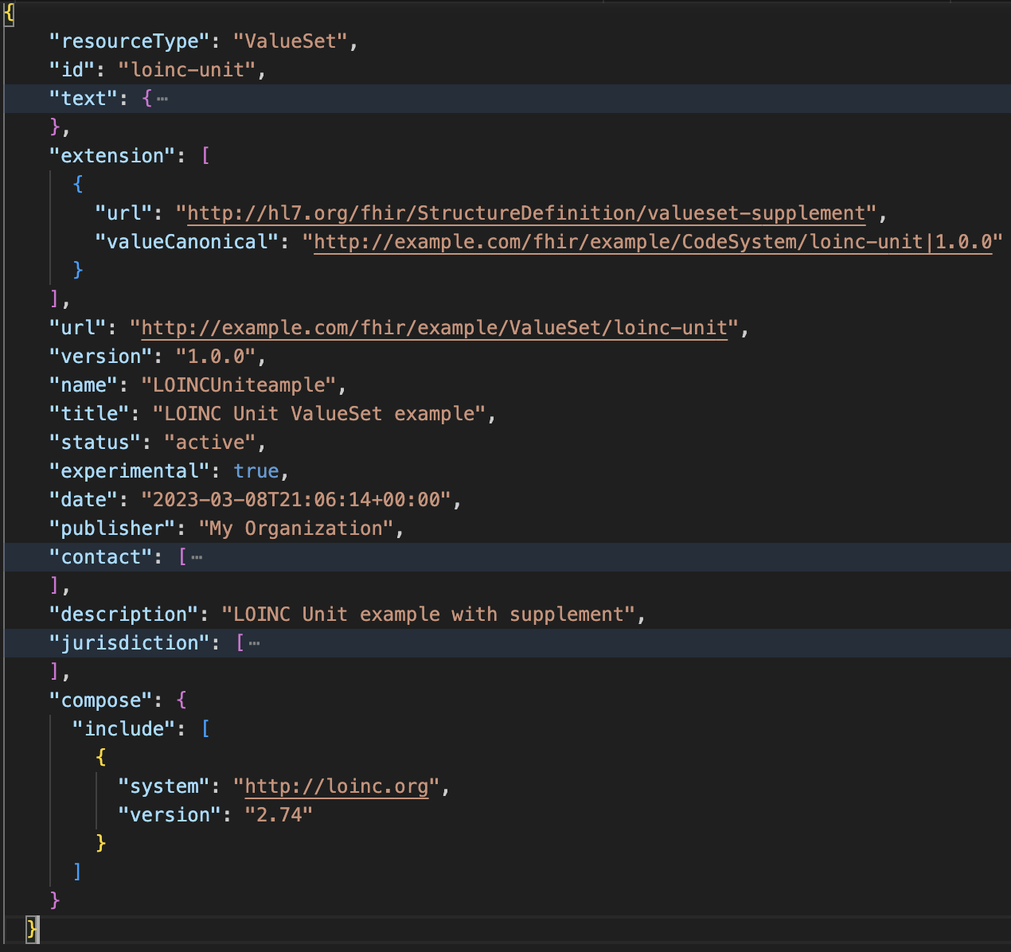
Adding properties

Slide 67
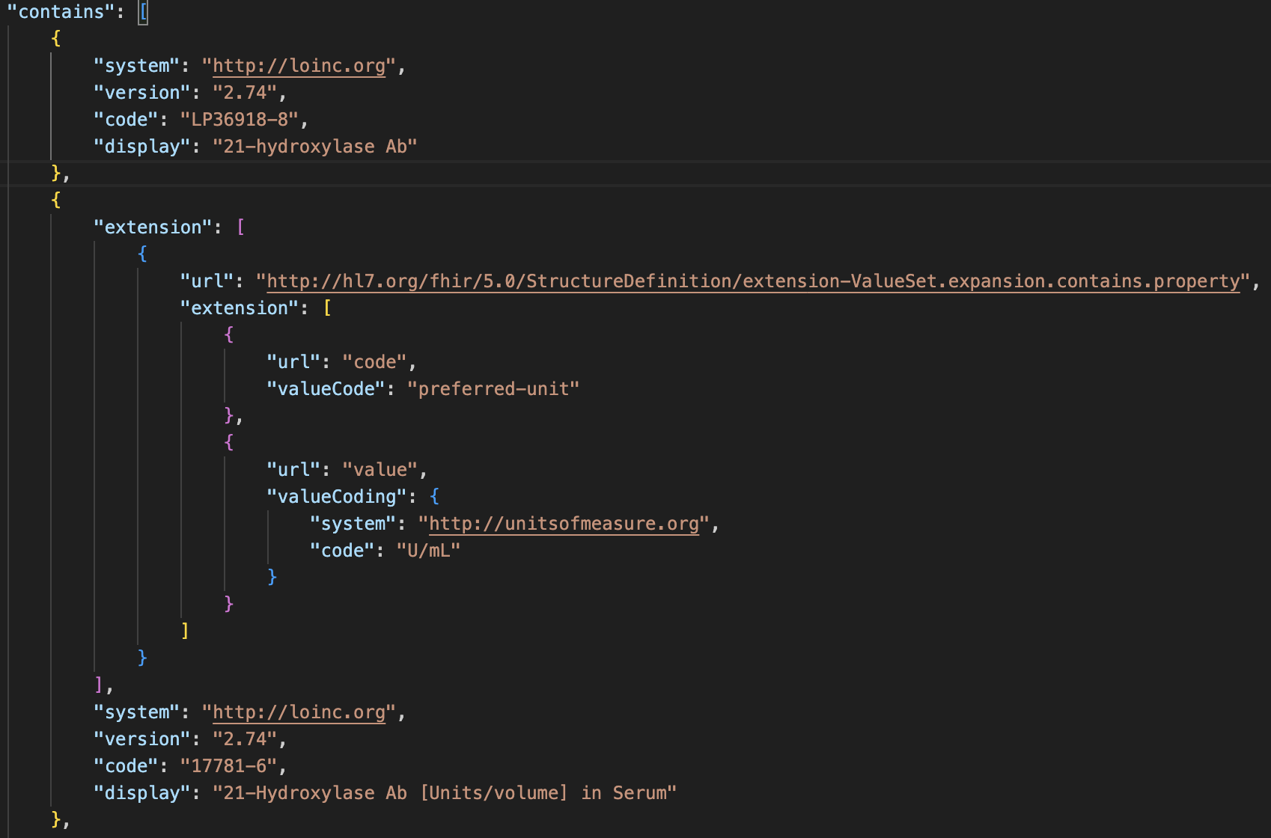
Requesting expansion properties
curl --location 'https://r4.ontoserver.csiro.au/fhir/ValueSet/loinc-unit/$expand?filter=21-Hydroxylase%20Ab&property=preferred-unit'

Slide 68
Labcodeset – a real life (and local) example
https://nictiz.nl/wat-we-doen/activiteiten/terminologie/nederlandse-labcodeset/
Adds
Status
Material
UCUM units
Translations

Slide 69
Validation implications
ValueSets can define display values for codes
ValueSet.compose.include.concept.display
Element Id | ValueSet.compose.include.concept.display
Definition | The text to display to the user for this concept in the context of this valueset. If no display is provided, then applications using the value set use the display specified for the code by the system.
But…for Implementation Guide and Resource validation, the ValueSet display must match either
The display or one of the designations from the CodeSystem, or
one of the designations from an involved CodeSystem Supplement.

Slide 70
References for Servers and tools

Slide 71
Some Publicly Available Terminology Servers
Health Intersections (Grahame Grieve)
http://tx.fhir.org/ (FHIR build terminology server)
HAPI (University Health Network – James Agnew)
http://hapi.fhir.org/
OntoServer (CSIRO – Australia – Michael Lawley)
https://ontoserver.csiro.au/
https://r4.ontoserver.csiro.au/fhir (Ontoserver R4 server)

Slide 72
Some Publicly Available Terminology Servers
Value Set Authority Center (VSAC) – US National Library of Medicine (NLM)
https://cts.nlm.nih.gov/fhir/
Requires a UMLS account
Terminz (Patients First – New Zealand – Peter Jordan)
https://terminz.azurewebsites.net/fhir
Link to other publicly available FHIR servers (general and terminology)
https://confluence.hl7.org/display/FHIR/Public+Test+Servers

Slide 73
Some Useful Tools
clinFHIR (David Hay)
CodeSystem builder
http://clinfhir.com/codeSystem.html
ValueSet explorer
http://clinfhir.com/valuesetCreator.html
Query Tool
http://clinfhir.com/query.html
Postman
https://www.getpostman.com/

Slide 74
Some Useful Tools (cont.)
Shrimp SNOMED CT browser (CSIRO)
http://ontoserver.csiro.au/shrimp
CSIRO Value Set Comparison Tool
http://ontoserver.csiro.au/vstool
FHIR Tools release page
https://github.com/HealthIntersections/fhirserver/releases

Slide 75
Questions?
Connect with the FHIR community: FHIR Zulip chat terminology stream
https://chat.fhir.org/#narrow/stream/terminology
Or ask me: Rob Hausam
rob@hausamconsulting.com rrhausam@gmail.com Or you can send me a DM on the FHIR Zulip chat

